Slide 1
Framing and Evidence Analysis GMU Debate

Slide 2
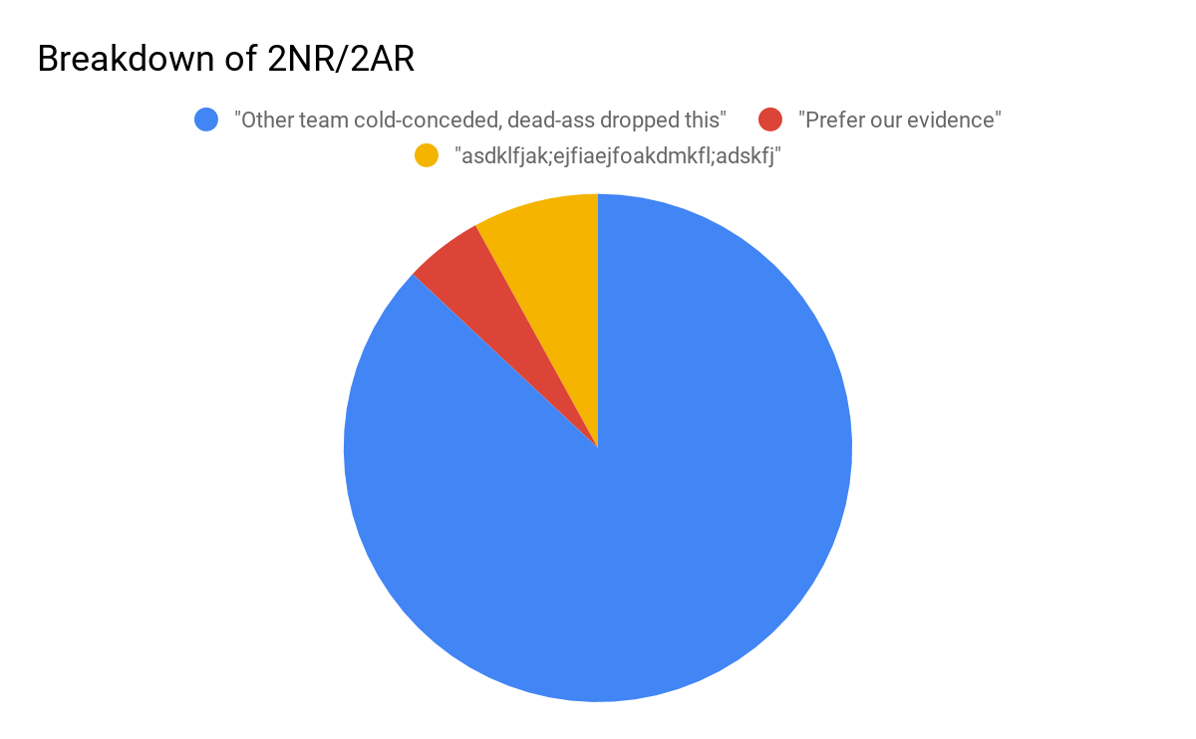
The problem
Debaters are often inefficient at extending evidence. Remember when you didn’t get to that argument(s) that cost you the round because you were “slow”?
Judges *ideally* do not want to read cards. When they do, they want instructions to help them decide the debate
8%
5%
87%

Slide 3
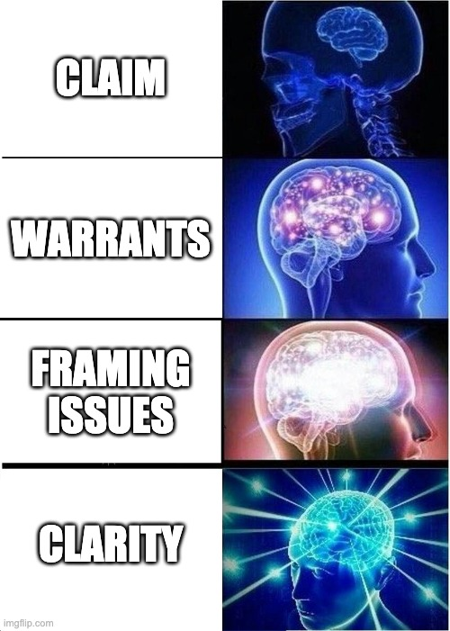
Scientifically proven ways to efficiently extend cards

Slide 4
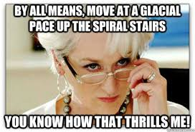
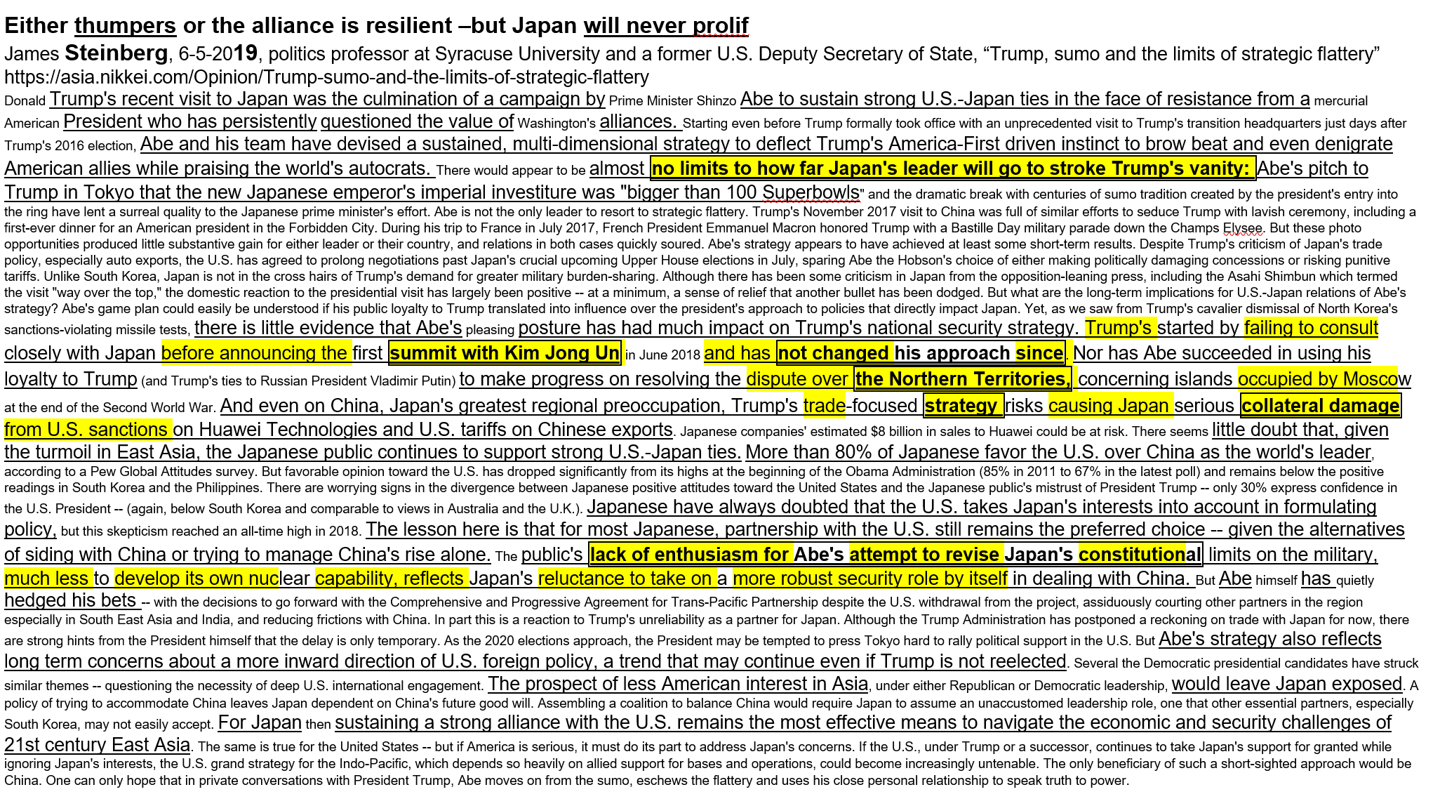
Step 1: Claim
Claims are central “thesis” of the argument. Be succinct and use a simple sentence structure
Don’t start your speech by saying “extend X”, get straight to point
Don’t just re-read the tagline (tagline extension)

Slide 5
Step 2: Warrants
Warrants should be either a simple sentence or be summarized as a series of keywords (consider bullet points for multi-warrant cards)

Slide 6
Step 3: Framing issues
Framing issues should be either explicitly called out as “Framing issues: X” or introduced by saying “Prefer our evidence because of X” or “Their evidence is bad/our is evidence is good because of X”

Slide 7
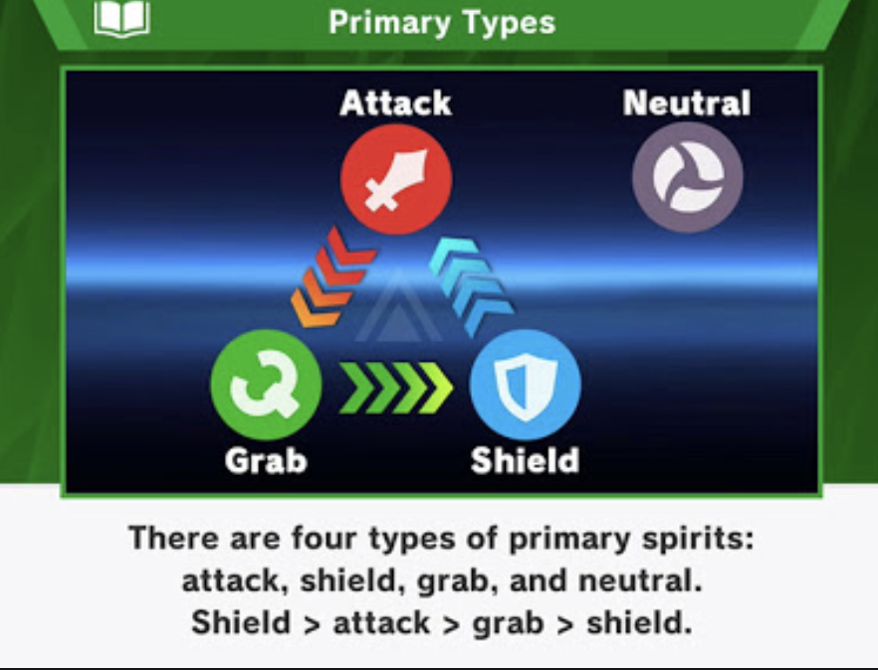
Example “framing” issues
Qualifications
Recency
“Fluff” or rhetorically powerful cards vs cards with warrants
Predictive vs snapshot
Long vs short cards (ie, the fortune cookies)
Methodology/Quality of internal warrants (opinions < studies/statistical analysis < meta-analysis)
Amount of cards read
Intent to define vs contextual (for topicality debates)

Slide 8
Example
Northwestern CE vs UNLV GH (Round 5 of Healthcare NDT)
2NR

Slide 9
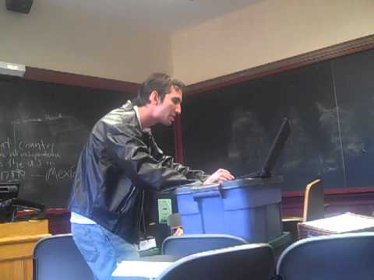
Example 3 (T Evidence)
Immigration Resolution: Resolved: The United States Federal Government should substantially increase the number of and/or substantially expand beneficiary eligibility for its visas for one or more of the following: employment-based immigrant visas, nonimmigrant temporary worker visas, family-based visas, human trafficking-based visas.
Kansas KQ Plan Text: The United States Federal Government should make individuals who file claims against their employers and do not have regularized immigration status eligible for T-visas.

Slide 10
Example 4
Georgetown BK v UGA RS
Round 7 2018 NDT
2AR
Entire top of the 2AR DA is filled with
Evidence framing!

Slide 11
What if you can’t come up with framing issues?
That means it’s not the argument you should go for or at best the argument should be viewed as way to cut down the risks of an argument, not as a “critical hit”

Slide 12
Uniqueness Questions

Slide 13
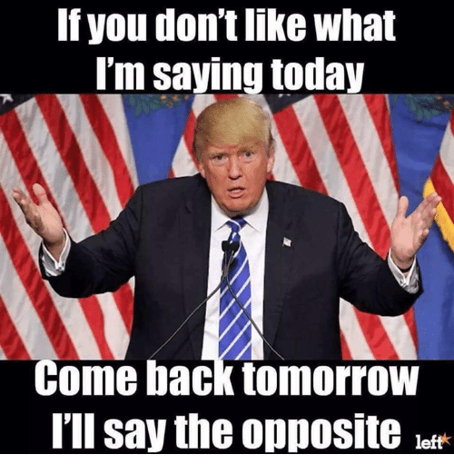
When is Recency Important?
Political Questions
Link Uniqueness Arguments
Impact uniqueness for current events
Ie outdated evidence that's out of context
When studies post-date one another

Slide 14
Types of Uniqueness: China DA Example
Overall uniqueness
High/low
Xi strong now
Link Uniqueness
Is the aff a unique instance that would trigger the DA?
China coop thumper said no
Impact uniqueness
Not doing something now/impact not yet happening
Chinese lashout not happening/Xi and CCP united now

Slide 15
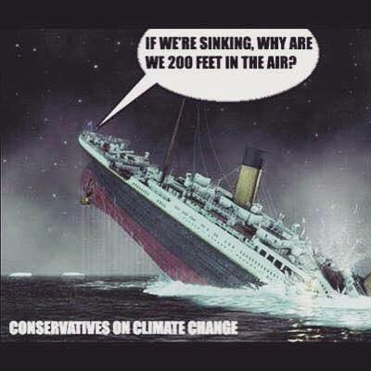
Predictive v. Snapshot
What is predictive evidence?
Makes claims about what will happen based on empirics
Important for long-term calculations (ex. incumbency advantage for elections)
Uses language indicative of future events
What is snapshot evidence?
Makes claims about what is happening
Important for uniqueness debates/short-term calculations (ex. current state of economy, senate vote counts on bills, etc.)

Slide 16
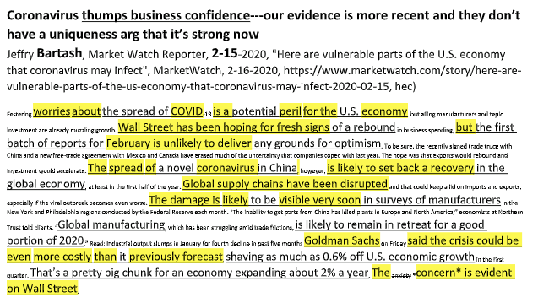
Example 1: Snapshot Evidence
Current issue
Percentages

Slide 17
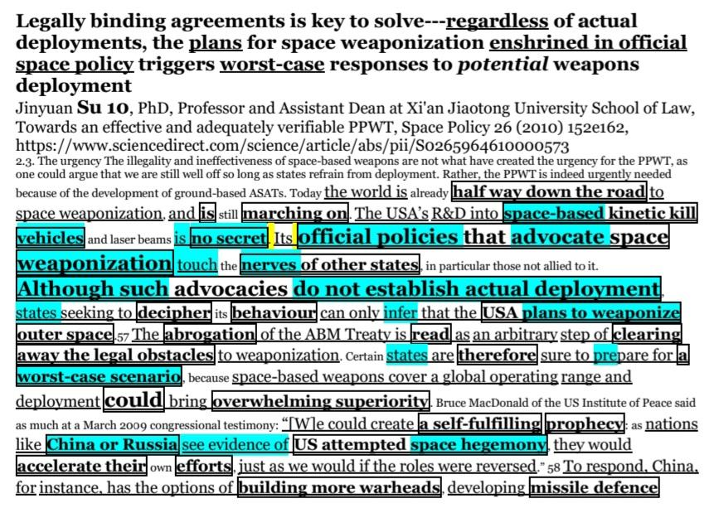
Example 2: Predictive Evidence
Predictive language--- indicative of future escalation

Slide 18
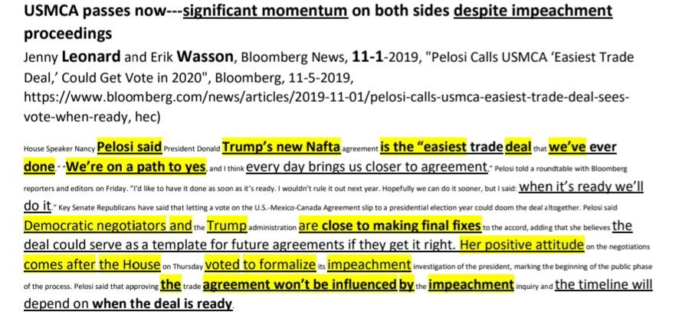
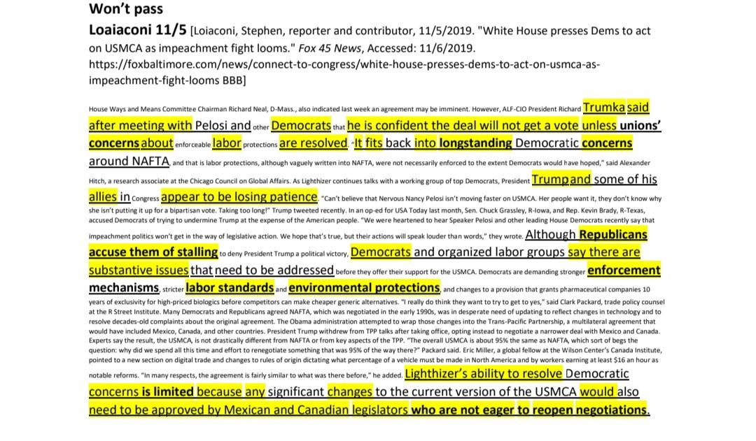
Exercise: USMCA DA Evidence (Pretend it is November): Compare the Two

Slide 19
All Levels Evidence Framing

Slide 20
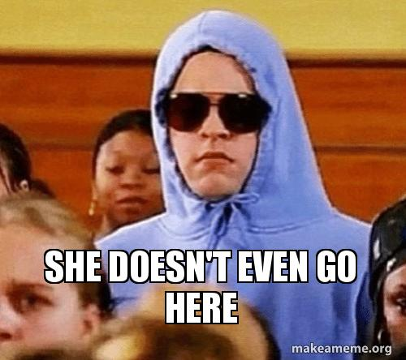
Framing Qualifications
Thesis: Who said it obviously matters
Questions to ask for debating qualifications:
Is it a discussion where who said it truly matters? Why?
Is citing qualified authors enough to make an unqualified authors’ opinions good?
Do their qualifications fit the subject matter?
For what purpose did they produce the scholarship? (Bias)
Do other qualified people agree with them?

Slide 21
Fluff vs. Warrants
Is this fluff or warrants?
You decide!

Slide 22
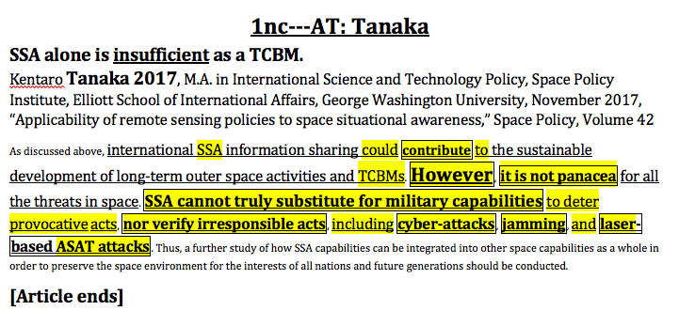
Long vs. Short Cards
When are short cards an appropriate choice?

Slide 23
Warrant Methodology
Meta-
Analysis
Good Studies/
Statistical
Analysis
OK Studies/
Statistical Analysis
Opinions
Opinion pieces - avoid using as a frame unless the person writing it matters (in which case the “qualifications” frame takes precedent)
Studies - What makes one bad/good/great?
(Sample Size, Length of study, Study Design, Author Bias, Expertly tested, theoretical basis)
Meta-Analysis - What is it?
Combine the results from multiple studies in an effort to increase power (over individual studies), improve estimates of the size of the effect and/or to resolve uncertainty when reports disagree.

Slide 24
Amount of Cards Read
Does 1 great card beat 3 terrible cards?
What about 1 well highlighted card versus 3 poorly highlighted cards?
What about 3 cards with separate warrants vs. 5 cards that all agree on one key warrant?
Depends on how you frame it!

Slide 25
Impact Framing

Slide 26
Magnitude
Utilitarian in most cases
But there is a reason magnitude should not be only considered this way (deontological claims have magnitude)
Impacts can cause other impacts to occur - which is higher magnitude.

Slide 27
Timeframe
Quicker impacts can matter more
Why? --- Intervening actors, more time to solve, etc.

Slide 28
Probability
Should shift the decision maker’s willingness to choose one impact over another
Likelihood can argued to be the best measure for how we make decisions
More often connected to structural impacts

Slide 29
Turns Case
IMPORTANT. Less articulated by younger debaters
Should always be coupled with your chosen frames.
Makes debates easier to win.

