Slide 1
Flowing Like a Pro GMU Debate

Slide 2
Content to Cover
What Flows Should Look Like: By Speech
Flowing K Tags
Tips and Tricks
Flowing Exercise

Slide 3
What Flows Should Look Like: By Speech

Slide 4
1AC (General)
Don’t flow it! If aff, you should know your aff. If neg, you should be focusing on neg prep.
Doesn’t help you
Uses up a column
Label the flow at the top LEFT
Tip: don’t waste a sheet marking solvency.
Spacing is critical, provide enough for 1NC arguments
Flow key parts---catching the whole tag is not important
Citations: don’t focus on them
Use a line to indicate ‘card’

Slide 5
1AC (Example)

Slide 6
1NC (General)
ONLY flow case args (both the aff and the neg)
Same reasoning as 1AC
1NC case sets the order of the case debate!
Anchor Speech
Identify off case scenarios/CP planks/T tricks/K links/alts to accurately prep 2AC
Identify floating internal links
1N should either flow the 1NC case during the 1AC OR the 2N should backflow the 1NC case during the 1NC.
Pros/Cons to each?

Slide 7
1NC (Case Example)
Analytic not caught entirely (often happens when they are first thing after transition)---ask about it in CX for clarity
LEAVE SPACE BETWEEN ARGS FOR THE 2AC
Flow case straight down in 1NC---sets the order for rest of the case debate
Use shorthand---
don’t flow the whole tag but make sure you accurately have the arg

Slide 8
1NC (Off-Case Example)
Leave space at the top for overviews
Label your flow
Don’t bother with citations

Slide 9
2AC (General)
Flow it all!
Order set for everything by this point
2AC sets off-case order
Anchor Speech
2AC follows 1NC case order
STAR arguments that are possible 2ARs
2AC should tell 1A what to begin prepping for 1AR
Neg should focus on these arguments in the block
!!!1A should backflow the 2AC off-case for the 2A!!!

Slide 10
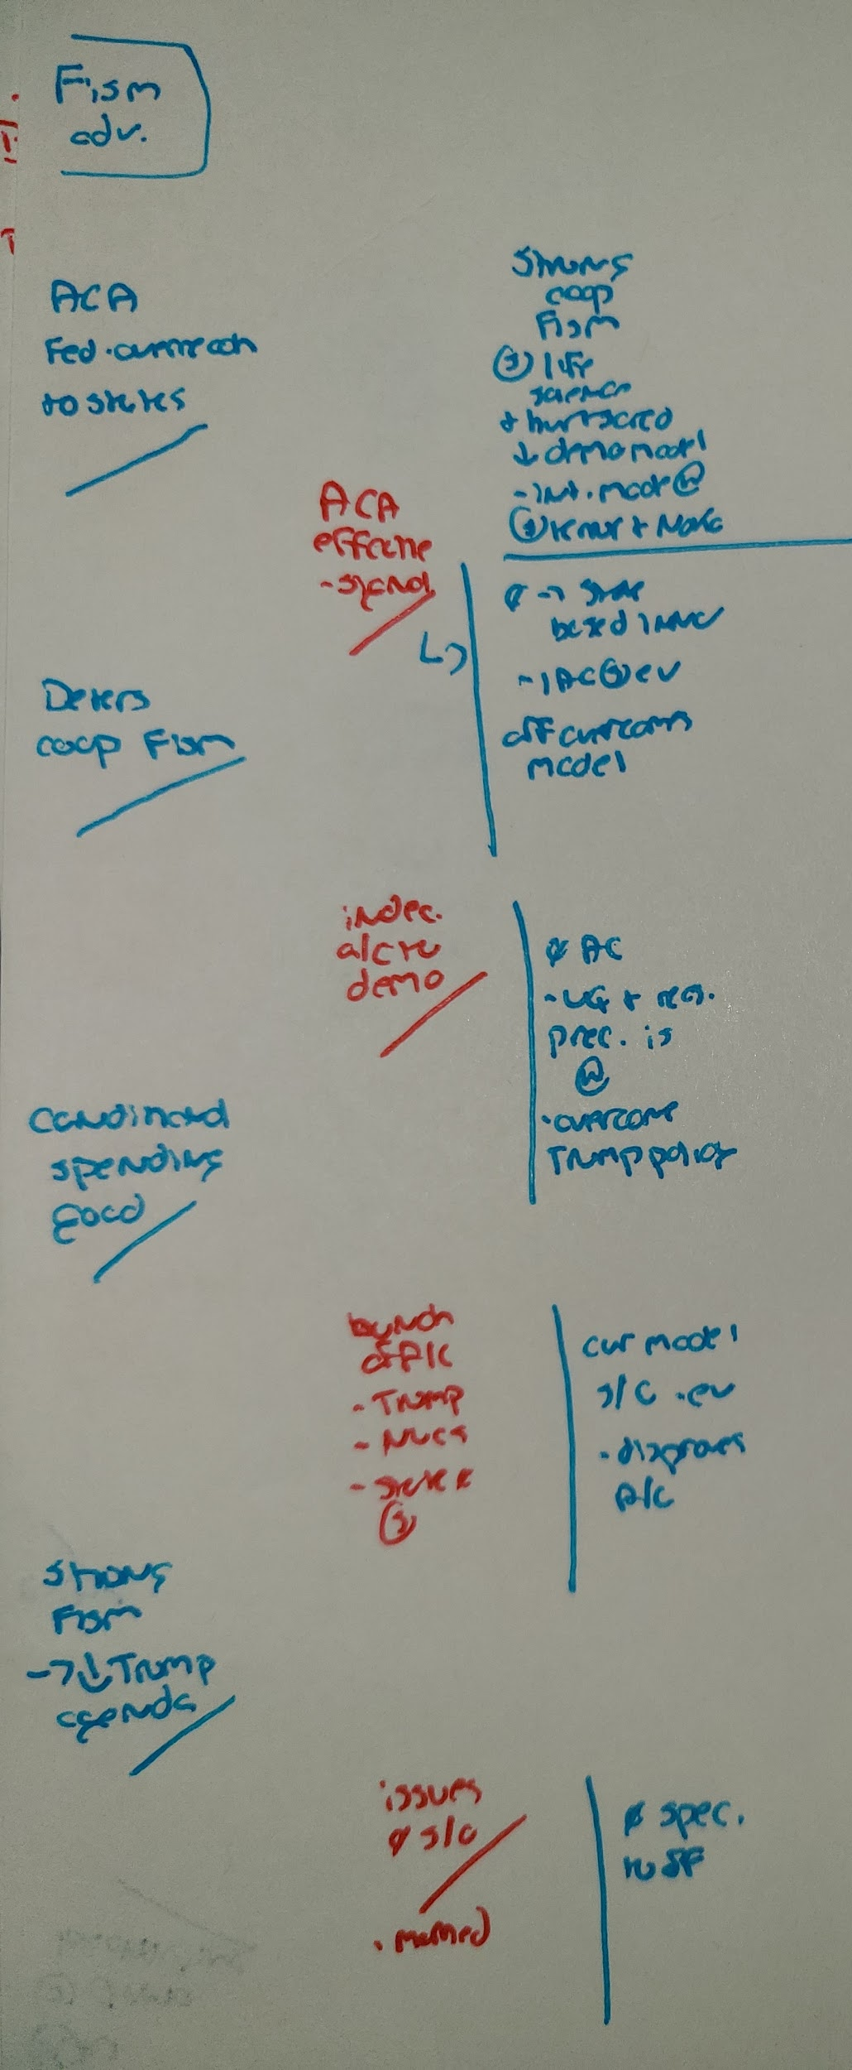
2AC (Example Case)
Overview was given in this speech
Show what answers what: arrows, lines, etc
LINE UP ARGUMENTS
Flow what’s relevant

Slide 11
2AC (Example Off-Case)
Leave space between args for the block
FLOW STRAIGHT DOWN

Slide 12
The Block (General)
Flow Impacts / overview at the top of the flow (did you leave a space?)
Line arguments based on the anchor speeches, but reconstruct/compartmentalize if you’re running out of spaces
Tricks are for kids, but you don’t want to drop them, so flag them on the flow
For the aff - should be using flows to determine which arguments you should go for!!

Slide 13
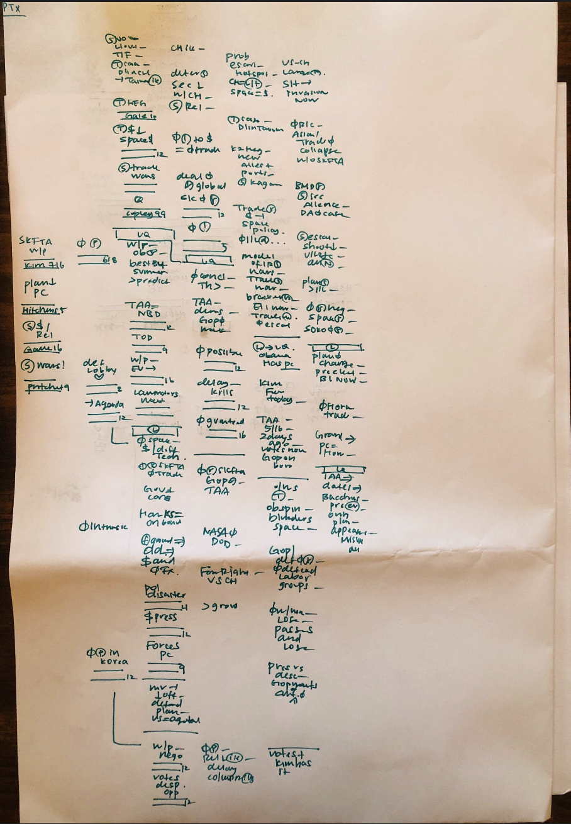
The Block (DA)
Write down 2ac warrants (1As)
Impacts / overview
Line-by-line starts (the neg responded to 2ac #1 won’t pass)
Ran out of space, but still compartmentalized through horizontal line

Slide 14
The Block (DA)
A quick quiz:
Based on the block coverage, which 2AC argument (A,B, or C) would you want to extend (ignore argument or evidence quality)
A
B
C

Slide 15
The Block (CP)
Type 1: Line-by-line CP
Type 2: Overview heavy CP
A lot of tricks here. You lose if you drop!
Watch out for “hidden” DA or solvency arguments.

Slide 16
The Block (T)
Strongly recommend reconstructing/compartmentalizing flows based on the block because T debates are mess
A lot of short / quick cards
Standards often blur together
People are incapable of doing line-by-line

Slide 17
1AR (General)
Factors that make flowing the 1AR different:
Time pressure
Cross-applications, grouping, illegitimate & rude new arguments
Narrowing down
Kicking flows correctly
Reconstructing flows
Line-by-line vs. straight down
For the neg: 2NR must close all the doors
Determining time allocation, addressing new cards/args
Notes:
Need to discuss doing line by line vs reconstructing flows/straight down

Slide 18
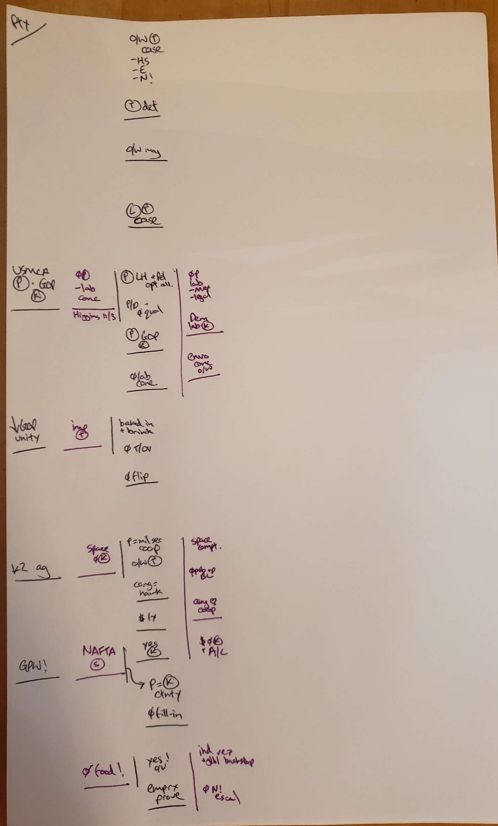
1AR (Flow)
2Ns can easily identify:
Dropped arguments
New arguments
Likely 2AR strategy/ which doors need closing

Slide 19
2NR
Focus on Outlining
-Grouping under argument types
-Utilizing headers
-Identify any “framing args” being used
-Identify specific ev cited for pre-2AR ev comparison prep
-Flow the 2nr with the 2ar in mind
Things to Avoid:
-Flowing straight down
-Excessive flowing

Slide 20
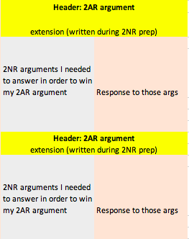
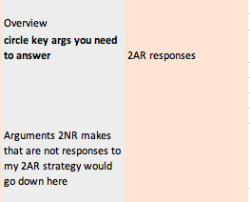
Flowing the 2NR as a 2Ar
To what works for you. Your 2NR flowing tactics may be different than other 2As, and that is fine.

Slide 21
Flowing K Tags

Slide 22
Flowing critique tags
Year after year and round after round we continue to reward teams finding the newest or most innovative ways to get to nuclear war, the more the counter-intuitive the internal-link chain the better! Our communities fixation with nuclear war goes back to at least to the early 80’s – even in the shadow of the Cold War’s cultural production of The Day After Tomorrow, Red Dawn, and War Games debate’s nuclear disaster imagery seemed detached from reality and drew criticism. Debaters from the 80’s were fully aware how a focus on contrived nuclear war scenarios was stunting debates potential for policy decision-making, topic education, and a larger place within academia.

Slide 23
Flowing critique tags
The nation state is founded on war based on the construction of a other against which it can pit its narrative of the invading enemy vermin. The blaming of the other for the violence of the state is an act of whitewashing that covers up the blood split on behalf of the civilized world. It is poetic terror that terrifies you for its reveals that we in essence torture ourselves in the name of security

Slide 24
Flowing critique tags
The call and response by the Left and Right is a repetition compulsion that conjoins apocalypse and restoration, always assuming the perpetuity of capitalism. The call to instrumentally restrict executive trade authority is a broken safety valve for an overloaded libidinal economy. Bernie and Trump represent two sides of the same entropic coin – capital’s self-negation.
Thus, our response to the Entropocene cannot ground itself on an appeal to some Real beneath the hyperreality of free trade and tariffs, Congress and the Executive, or Bernie and Trump. Instead, we have a choice: do we reinvest our libidinal energy yet again into the fascist cycle of politics or do we take the leap into Beyond in search of new desires?
Armand, 18 (Louis Armand is a Prague writer, theorist & visual artist; “CONSPIRACIES OF THE FUTURE,” ALIENIST Magazine #4 (December 2018): RAGE AGAINST THE ALGORITHM, https://alienistmanifesto.wordpress.com/2019/01/09/conspiracies-of-the-future/#more-742)

Slide 25
Tips & Tricks

Slide 26
Tips and tricks
Reading your flows faster
Using prep time effectively
Triggers vs. Readers
The two easy mistakes
The biggest debate about flowing
One silly tip before tournaments

Slide 27
Practice!

Slide 28
1NC & 2AC 39:45

Slide 29
Homework
https://speechdebate.binghamton.edu/Videos/Debates/Policy-Live/138/2014-2015-legalization-topic---open-rounds/emory-kl-vs--gmu-kl---ada-nationals--2015--octos/
Flow the above debate on paper and send to your current group coach by Sunday night. We will schedule a time to meet with you to review.

